Slide 1
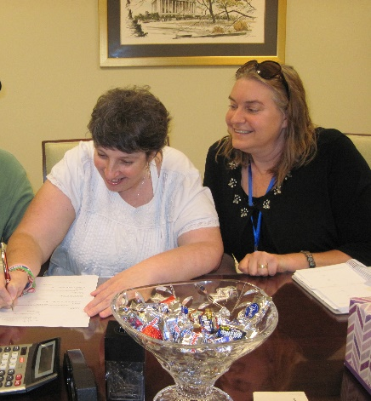
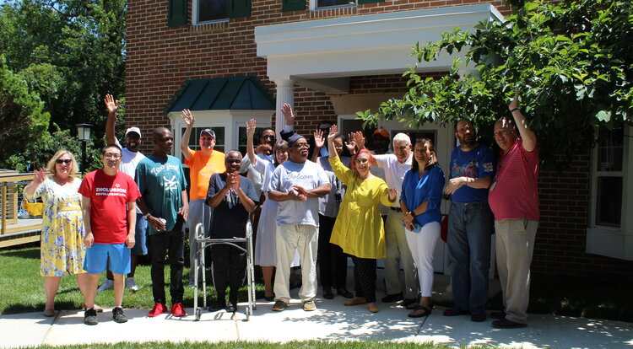
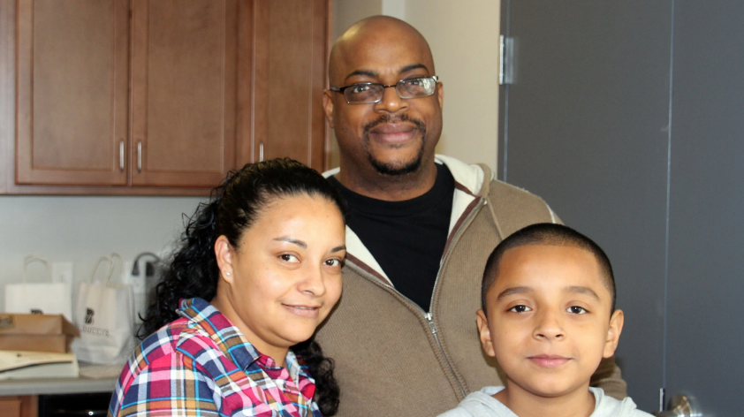
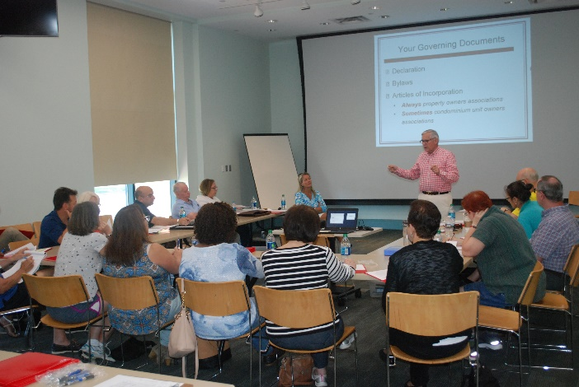
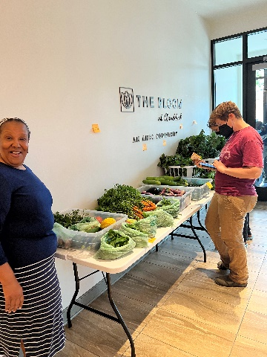
NCDA Annual Conference 2024 PRESEVATION
City of Alexandria, VA
Eric Keeler, Deputy Director, Office of Hosing
https://www.alexandriava.gov/Housing
1

Slide 2
Office of Housing
Provides landlord-tenant services (complaint resolution, mediation, and relocation assistance) and eviction prevention
18*-member strong
* ARPA $ are supporting expansion of landlord-tenant work (7/21-12/24)
Develops affordable housing policy
Conducts fair housing testing and training
Provides loans and technical assistance to partners
Provides home purchase assistance and training, foreclosure prevention, and condo governance education
Works to secure affordable units through development
Runs home rehabilitation loan program, and manages rental accessibility grants

Slide 3
RENTER HOUSEHOLDS
OWNER HOUSEHOLDS
WITH INCOMES UP TO $75K
WITH INCOMES UP TO $75K
86%
69%
~14,900
~3,400
# HOUSING COST BURDENED RENTER HOUSEHOLDS WITH INCOMES UP TO $75K
# HOUSING COST BURDENED OWNER HOUSEHOLDS WITH INCOMES UP TO $75K
Source: ACS, 5-Year Estimates 2018-2022

Slide 4
Our HOUSING BY THE NUMBERS
~50+ ADUs approved (internal & external)
Source: Office of Real Estate Assessment, February 2023; Office of Housing, July 2023

Slide 5
~83,800 Estimated number of residential units in the City (Office of Housing, July 2023)
MARKET AFFORDABLE (~8,300 in 2023*)
non-subsidized units affordable due to their age, amenities, condition, and/or location
COMMITTED AFFORDABLE (~5,000 in 2023)
units receiving assistance (local and/or federal) or made affordable through developer contributions
Rental and for-sale set-aside units secured through development process, including through bonus density and height
Publicly assisted housing units (public housing, nonprofit housing projects, HUD-funded affordable units in privately-owned properties)
AFFORDABLE CONDOMINIUMS (~4,700 in 2023)
units assessed up to $249,000
HOUSING OPPORTUNITY
* Total market affordable units are subject to fluctuation based on rent increases and annual AMI adjustments; an increase in total market affordable units does not necessarily indicate increasing rental affordability. The Office of Housing annual Apartment analysis factors a utility adjustment when calculating gross rents and total housing cost.

Slide 6
Preservation Process
Good Information
Available Resources
Building Relationships

Slide 7
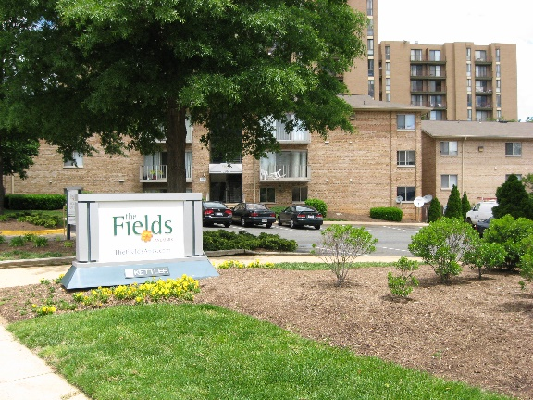
Information for Preservation
From Partners
Virginia Housing Finance Agency
US Department of Housing and Urban Development
National Housing Trust
Data Sources
CoStar – Market Affordability
Local Collection

Slide 8
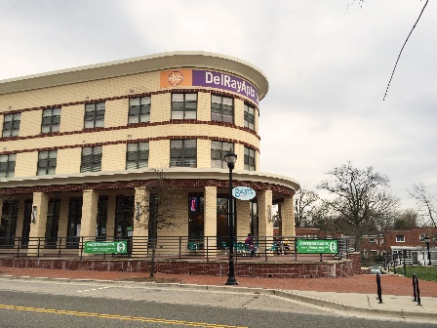
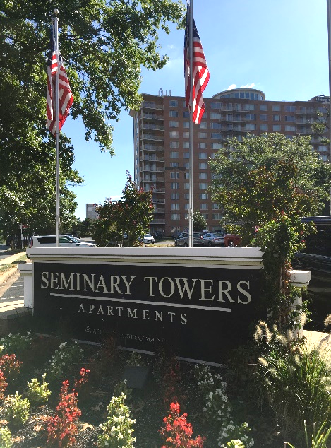
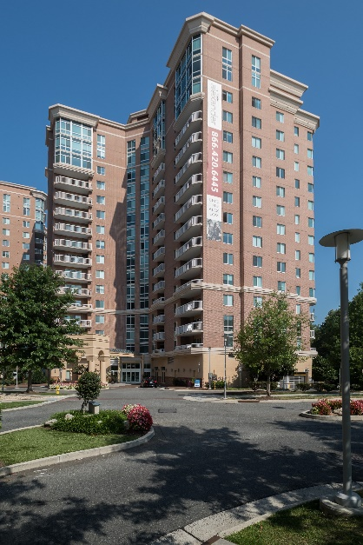
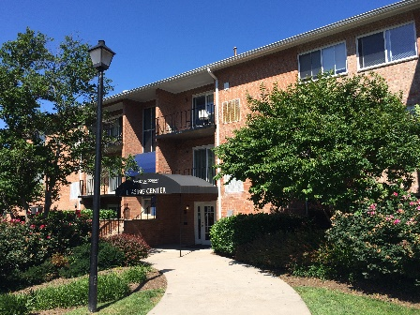
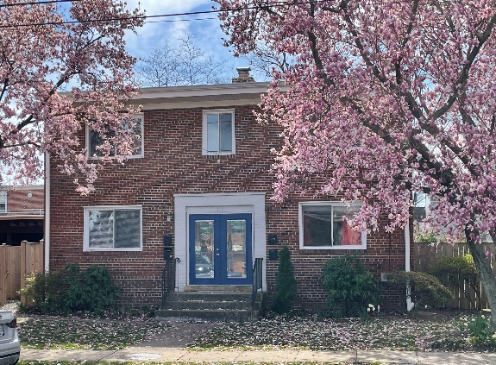
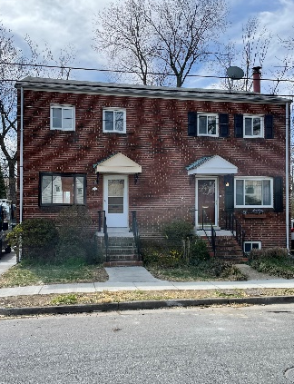
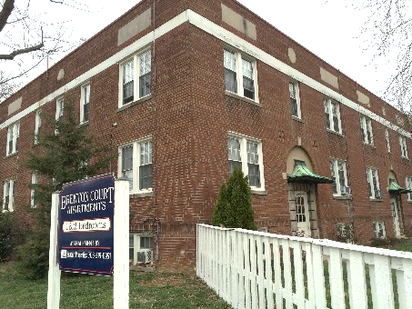
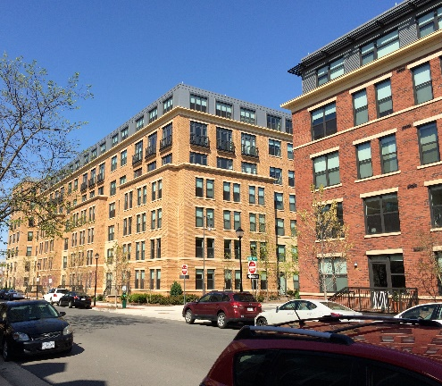
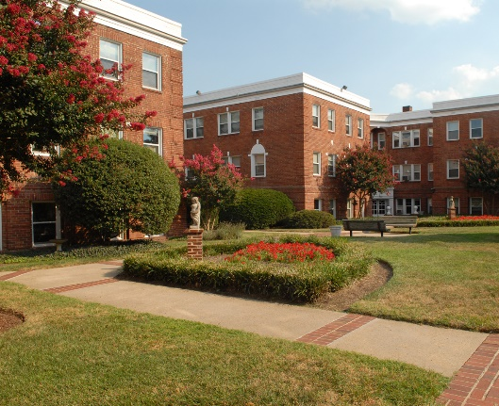
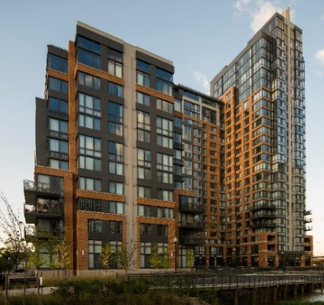
~$2,050
2023 AVERAGE 1-BEDROOM MARKET RENT, including UTILITIES
~$2,570
2023 AVERAGE 2-BEDROOM MARKET RENT, including UTILITIES
Source: Point in Time Analysis by Office of Housing, 2023; CoStar

Slide 9
Resources for Preservation
City Dedicated Housing Funds - $11-12M Annually
Meals tax (1%)
Penny Fund (1 cent)
HOME Funds
CDBG Funds
Section 108
Cash Capital – CIP
General Obligation Bonds
Funders
Virginia DHCD
Virginia Finance Agency
Freddie Mac
Amazon Equity Fund
JBG Smith
Partners
Housing Alexandria
Wesley Housing
Community Lodgings
https://www.alexandriava.gov/housing-services/developer-resources

Slide 10
Multifamily Lending Program
Provide gap funding
2% interest financing
Not must Pay - Payment Based on Cash Flow
Restrictive Covenants
Right of First Refusal
40 years affordability term

Slide 11
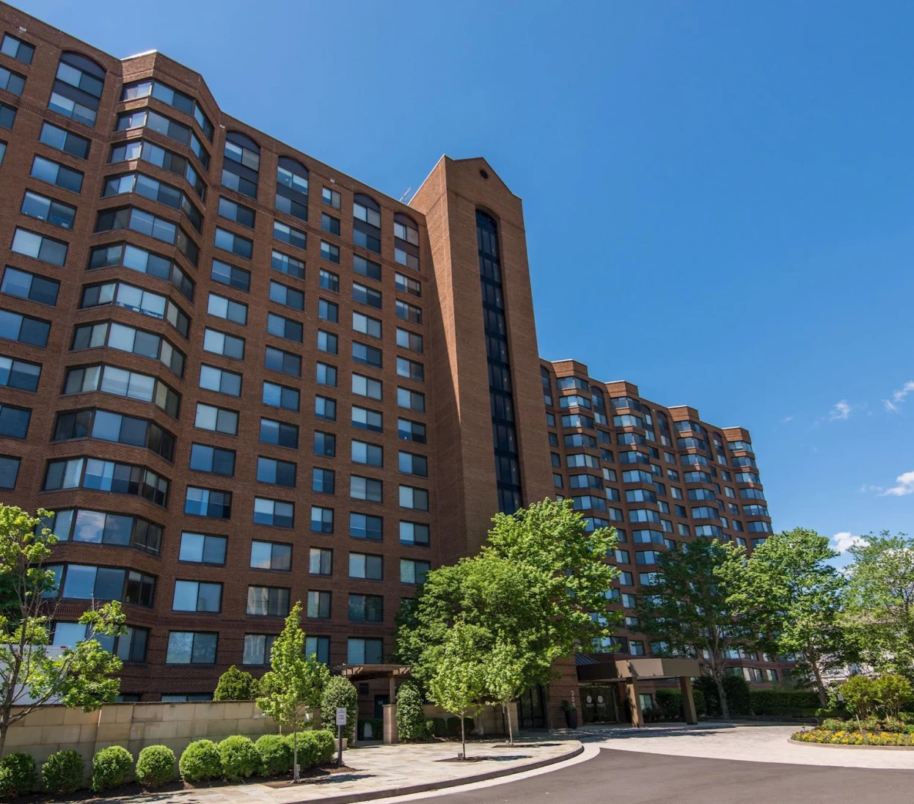
Parkstone Housing Alexandria
Property Info
Purchased 2020
High Rise
Located in Alex West section of Alexandria
Originally a Tax-Exempt Bond Project New Construction
Built 1989
Units 326 units
Affordable to 60-80% Ami and Market
$315K a unit
Onsite amenities include a pool, tennis court, open space, grill areas, dog parks, fitness center, bike storage, parking, community rooms, business center
Financing
Virginia Housing First Trust
JBG Smith Mezzanine Debt
City Gap Funding $8m
From the broker’s offering statement:
“NO AFFORDABLE COMPONENT
Unlike the majority of the Property’s rental comparables and nearly all of the newer deliveries in the area, Avana Alexandria is comprised entirely of market rate units. The lack of an affordable component at the Property, which is rare for a large multifamily asset in Northern Virginia, permits ownership to maximize revenue through market rate rental increases for each apartment home and will therefore allow a buyer to realize impressive returns.”

Slide 12
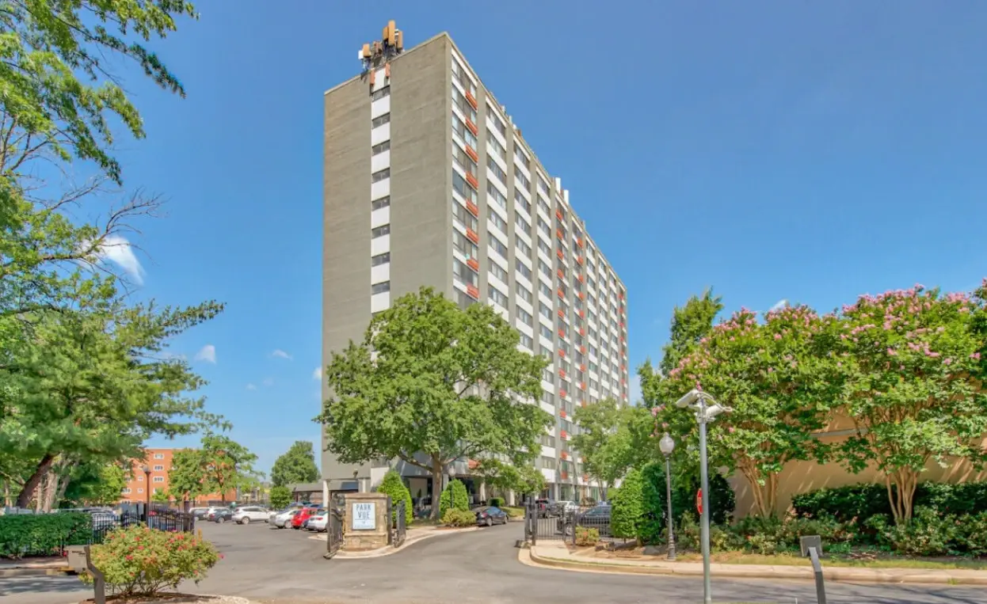
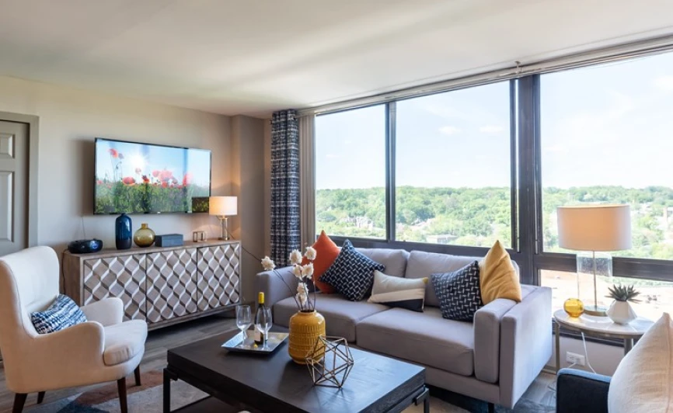
Square at 511 Housing Alexandria
Property Info
Purchased 2022 - Refinanced in 2024
High Rise 14 Stories
Located in Arlandria section of Alexandria
Built 1965
197 Units
Affordable to 40 -60% Ami
$290K a unit
Amenities
Surface Parking
Financing
Freddie Mac
Amazon Equity Fund
City Commitment for $5m for Property Upgrades

Slide 13
Residential Multi-family Zone
What is the RMF zone?
The RMF Zone was created in 2019 to implement the housing affordability goals of the 2018 South Patrick Street Housing Affordability Strategy which sought to proactively address expiring federal housing assistance contracts that threaten two of the city’s deeply affordable communities, The Heritage at Old Town and Olde Towne West III (OTW). The Heritage and OTW’s combined 215 committed affordable units currently serve households with incomes reaching as low as approximately 20-30% of the area median income (AMI).
https://www.alexandriava.gov/planning-and-zoning/zoning-for-housinghousing-for-all
https://storymaps.arcgis.com/stories/64246f5ba49f41159c59858e59c559b3

Slide 14
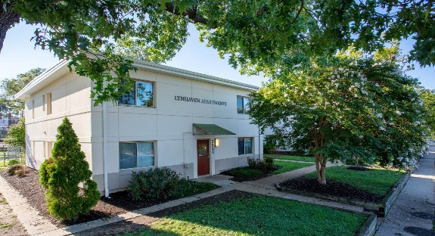
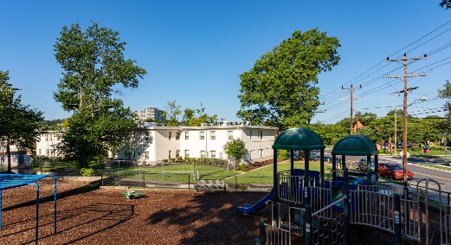
Lynhaven Wesley Housing
Property Info
Purchased 2002
Garden Style
Located in Arlandria section of Alexandria
Built 1949
2014 Full Rehab with 4% Credits and Bonds
28 Units
Affordable to 60% Ami
Financing
Virginia Housing First Trust
City Gap Funding Second Trust
Tools
Land banking future development possibility

Slide 15
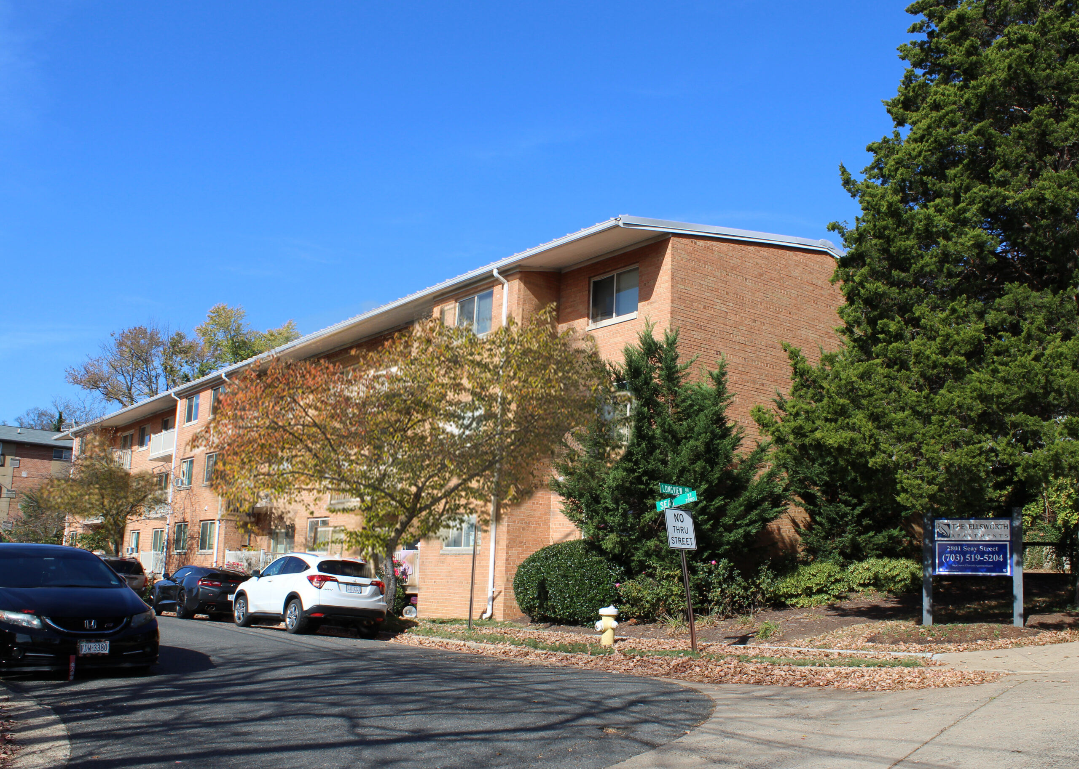
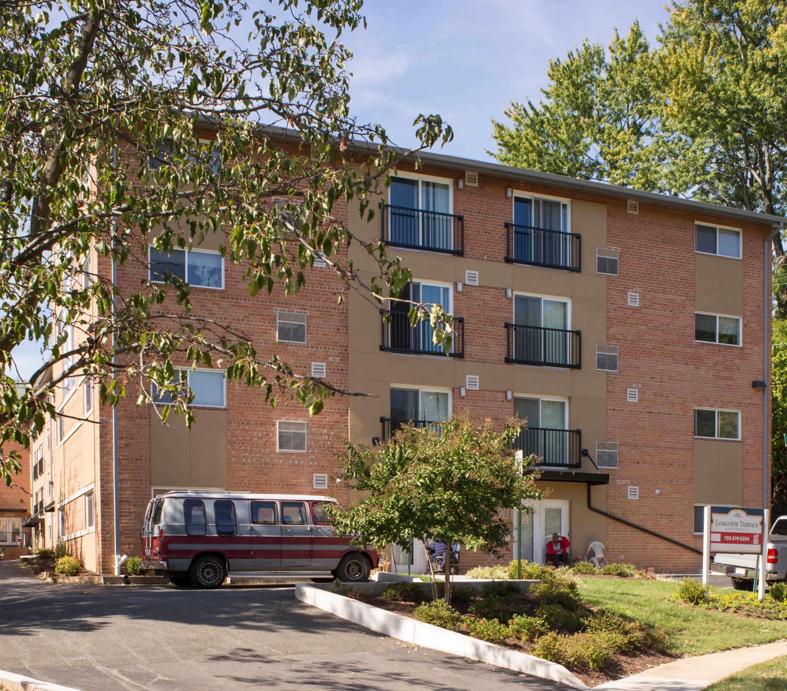
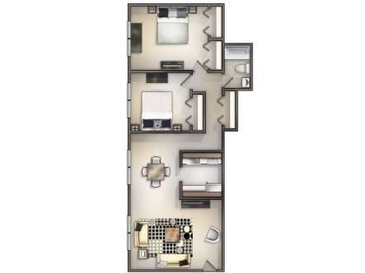
Longview and Ellsworth Housing Alexandria
Property Info
Longview Purchased 2011 – 41 units
Ellsworth Purchased 2019 -20 units
Garden Style
Located on Duke Stret Corridor of Alexandria
Built 1960s
Units
Affordable to 60% Ami
Financing
City Gap Funding
Tools
Land banking

